Slide 1

Chhattisgarh Swami Vivekanand Technical University University Teaching Department Department of Computer Science and Engineering
Presented By
Sneha Jha
Roll No. 19
Branch: Data science
Minor Project Presentation
On
Advanced Stock Price Forecasting Using a Hybrid Model of Numerical and Textual Analysis
Guided by :-
Mr. Ramakant Ganjeshwar
Assistant Professor
Madhurima Rawat
Roll No. 42
Branch: Data science
Geetanshu Dev Meshram
Roll No. 43
Branch: Data science

Slide 2
Content
Problem Statement
Literature Review
Research Methodology
Expected Outcome
Discussions
Scope of Project
Progress So far

Slide 3
Problem Statement
Objective of Stock Price Prediction: The primary objective is to develop a robust predictive system that forecasts stock prices based on historical financial data from companies, specifically utilizing datasets from TCS and Google.
Integration of Numerical and Textual Data: Our challenge lies in creating a hybrid forecasting model that effectively integrates time-series numerical data with insights derived from Natural Language Processing (NLP) of financial news and reports, enhancing the prediction accuracy of stock prices.
Handling Time-Series Data: The project aims to efficiently manage and store extensive time-series datasets through InfluxDB, ensuring optimal performance and scalability in processing historical stock price information and facilitating rapid data retrieval.
Adoption of Advanced Machine Learning Techniques: We are committed to exploring and implementing advanced machine learning algorithms, such as ARIMA, LSTM, and Transformer models, to refine our predictive analysis, enabling the system to adapt to market dynamics and improve forecasting reliability.

Slide 4
Literature Survey
1. IET Research: Advanced Stock Price Forecasting
This paper explores the use of machine learning models, specifically LSTM and ARIMA, to improve the accuracy of stock price predictions. It emphasizes the importance of integrating technical indicators and historical price data for model training. The study highlights that LSTM's ability to capture long-term dependencies makes it superior in predicting nonlinear stock price movements compared to traditional models like ARIMA.
2. MDPI: Dealing with Nonlinearity in Stock Prices
This research addresses the nonlinear nature of stock prices and presents various machine learning techniques that can effectively handle this complexity. The paper discusses the benefits of hybrid models, combining traditional statistical methods with deep learning algorithms to better predict stock market behavior. The study also highlights the advantages of neural networks for capturing nonlinear relationships in financial data..

Slide 5
Literature Survey
3. MDPI: Hybrid Model for Stock Price Prediction
The paper proposes a hybrid model that combines technical analysis with machine learning techniques to predict stock closing prices. It focuses on blending time-series analysis with sentiment analysis of financial news, which enhances the model's predictive capabilities. The hybrid approach demonstrates improved accuracy in forecasting stock prices by factoring in both historical price data and market sentiment.

Slide 6
Research Methodology
Literature Review and Dataset Exploration: We are analyzing relevant research papers to identify suitable methodologies and exploring datasets focused on stock price information from companies like Apple, Google, and TCS.
Natural Language Processing (NLP): We are emphasizing NLP to analyze financial news and reports, evaluating tools like NLTK and spaCy to extract insights that will enhance our hybrid forecasting model.
Advanced Machine Learning Algorithms: We are studying algorithms such as ARIMA, LSTM, and Transformer models, aiming to integrate these with textual analysis to develop a comprehensive forecasting model that improves prediction accuracy.

Slide 7
Research Methodology
Time-Series Data Management: We are learning to use InfluxDB for efficient storage of time-series data, enabling optimal performance and scalability for moderate-sized datasets.
Data Visualization and Collaboration Tools: We are learning to use Grafana for data visualization and real-time dashboards, and we have set up a GitHub repository for effective version control and project management.

Slide 8
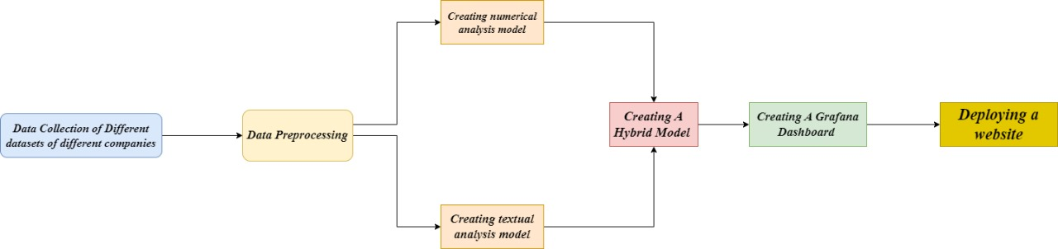
System Flowchart

Slide 9
Expected Outcome
We aim to develop a comprehensive deployed website using Streamlit, along with a Grafana dashboard hosted on localhost. The primary features will include:
Stock Price Prediction: The Streamlit website will allow users to input various stock parameters, such as high, low, and open prices, and will predict the closing price based on these inputs.
Sentiment Analysis from News: We will gather news headlines and articles as input, performing sentiment analysis to predict market trends. Based on the sentiment, the system will determine whether the market is bullish (uptrend) or bearish (downtrend).
Data Storage and Accessibility: We will utilize InfluxDB for efficient data storage, ensuring that our dataset can be accessed at any time.
Historical Data Visualization: The Grafana dashboard, running on localhost, will visualize historical data, enhancing user understanding of trends and providing insights into stock performance over time.

Slide 10
Discussions
Our project, Advanced Stock Price Forecasting Using a Hybrid Model of Numerical and Textual Analysis, focuses on predicting stock prices using both numerical data and financial news.
Dataset Preparation: We've completed data preprocessing and EDA for stock data from TCS and Google, which will be integrated into the model.
Text Data Preprocessing: Initial cleaning and preprocessing of financial news data is underway for sentiment analysis.
Research and Learning: We are reviewing research papers and algorithms. We plan to build separate models for numerical and textual data before integrating them into a hybrid model.
Next Steps: The next phase includes model building and integration, followed by deployment on Streamlit and creating the Grafana dashboard for visualization.

Slide 11
Scope of Project
The Advanced Stock Price Forecasting Using a Hybrid Model of Numerical and Textual Analysis project aims to build a hybrid model that integrates numerical stock data and textual analysis from financial news. The scope includes:
Data Collection and Preprocessing: Handling time-series stock data (TCS and Google) and textual data (financial news) with InfluxDB for storage and using NLP for textual sentiment analysis.
Model Building: Developing separate models for numerical data and textual data, followed by integration into a hybrid model for enhanced prediction accuracy.
Visualization and Deployment: Deploying the model using Streamlit and creating a Grafana dashboard for real-time and historical stock data visualization.
Scalability: Ensuring the system is scalable for future expansions, both in terms of larger datasets and more complex models.

Slide 12
Progress So far
Dataset Analysis and Selection: We have analyzed multiple available datasets and finalized two key datasets—TCS and Google—for training our model. These datasets contain stock-related columns such as:
Date: The trading date (to be used as the index).
Open, High, Low, Close: The stock prices at the opening, highest, lowest, and closing times of the day.
Adj Close: Adjusted closing price considering factors like dividends.
Volume: The number of shares traded during that day.
Data Preprocessing: All preprocessing tasks have been completed. We removed missing values as they were minimal and insignificant to the analysis. An extensive EDA was conducted, confirming the absence of outliers, making the dataset reliable for model training.

Slide 13
Progress So far
Next Steps: Moving forward, we may conduct additional preprocessing based on model requirements. The Date column will be set as the index, and we will generate visualizations to show the dataset distribution and trends.
Model Training and Evaluation: The model has been trained on the dataset. Next, we will evaluate its performance by analyzing key metrics like accuracy, precision, recall, and other relevant parameters to assess its effectiveness in predicting stock prices.

Slide 14
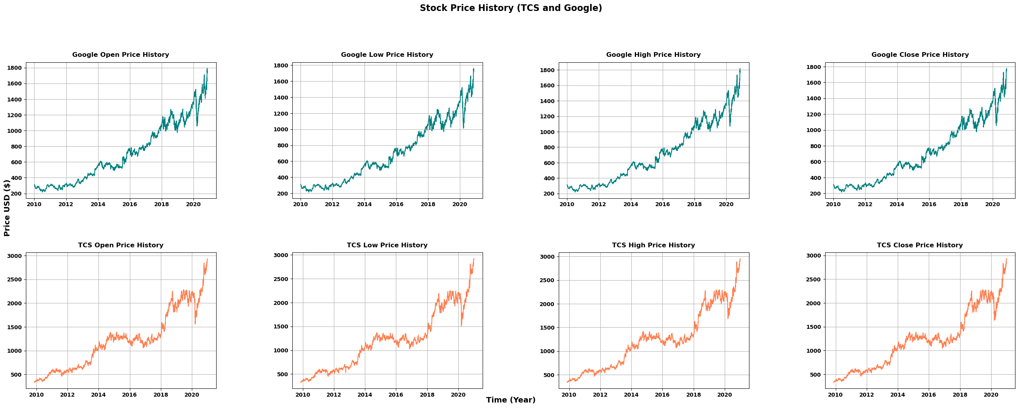
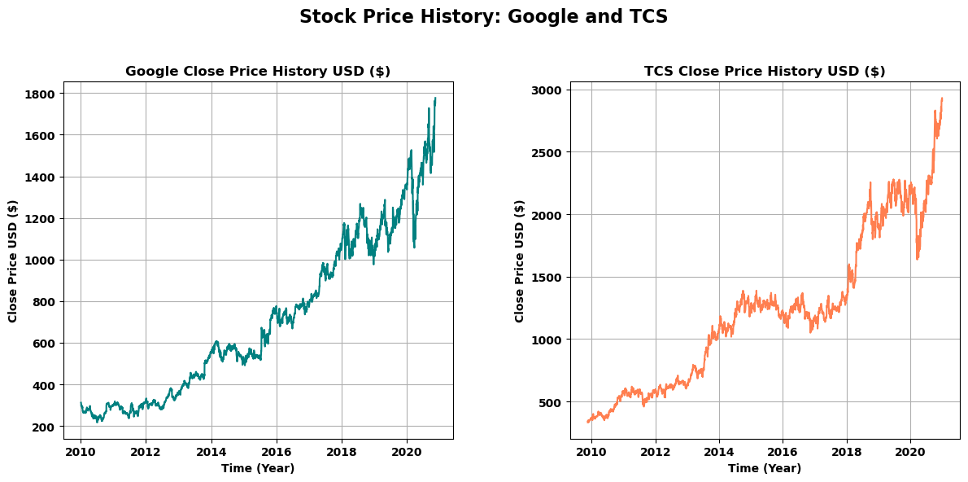
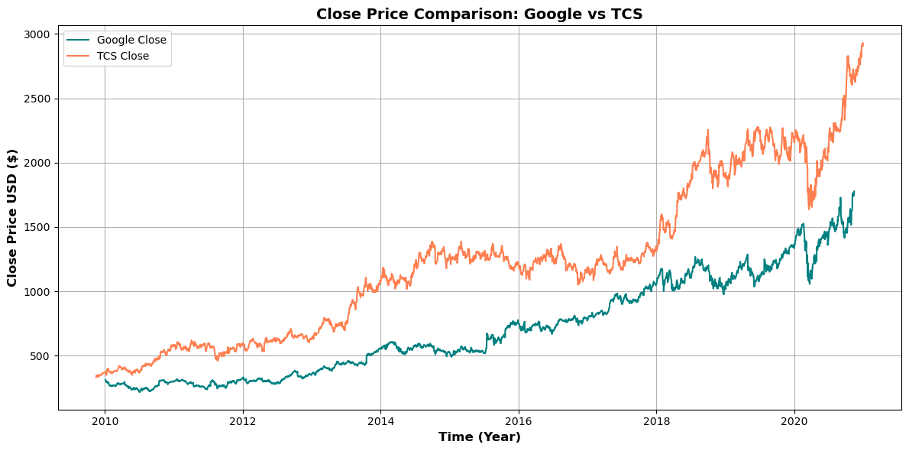
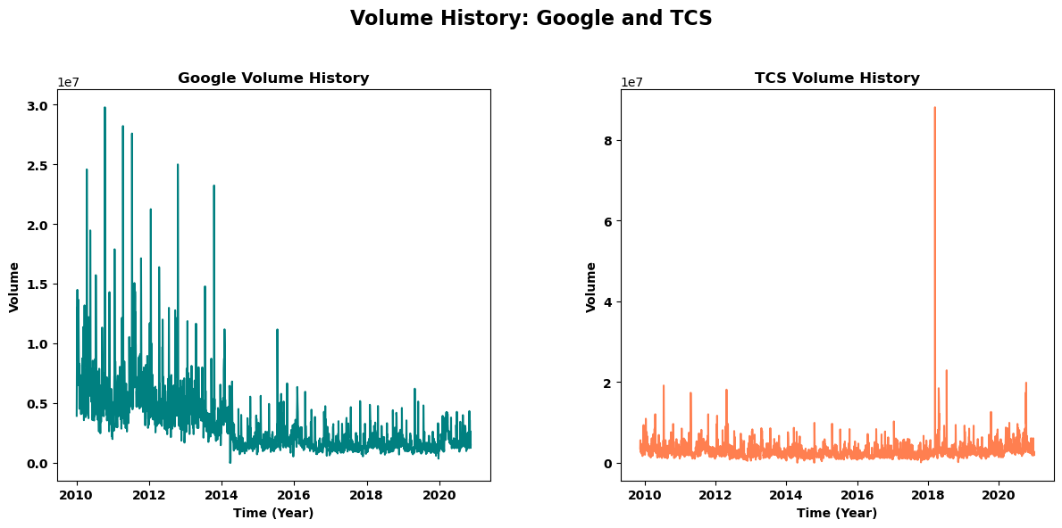
Dataset Visualization

Slide 15
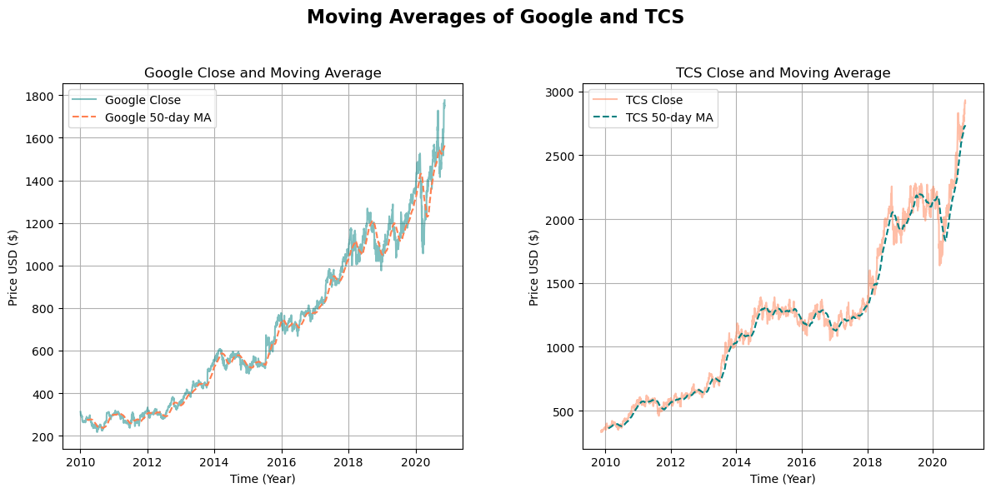
Moving Averages

Slide 16
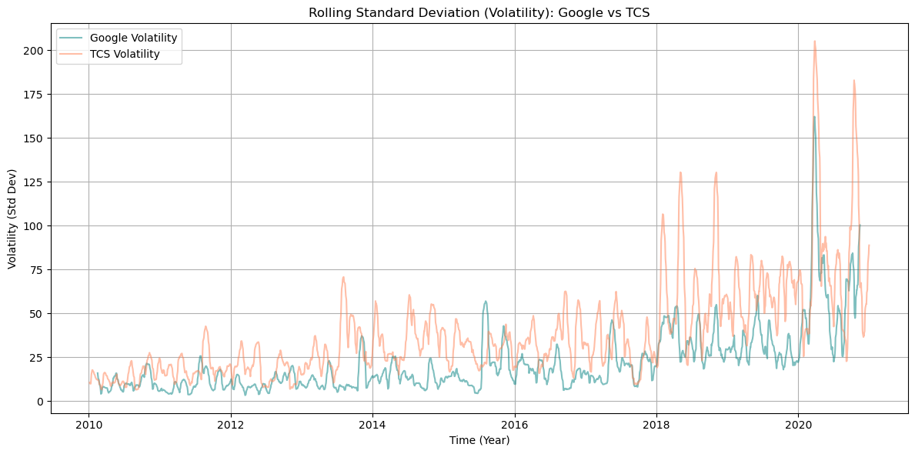
Rolling Standard Deviation

Slide 17
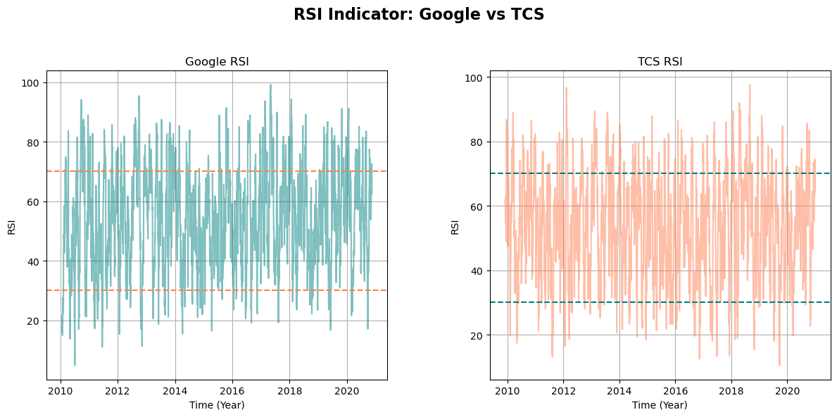
RSI Plot

Slide 18
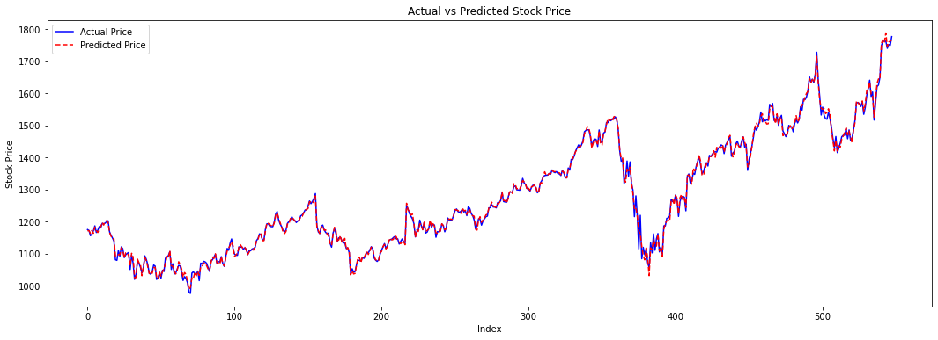
Google ML Prediction

Slide 19
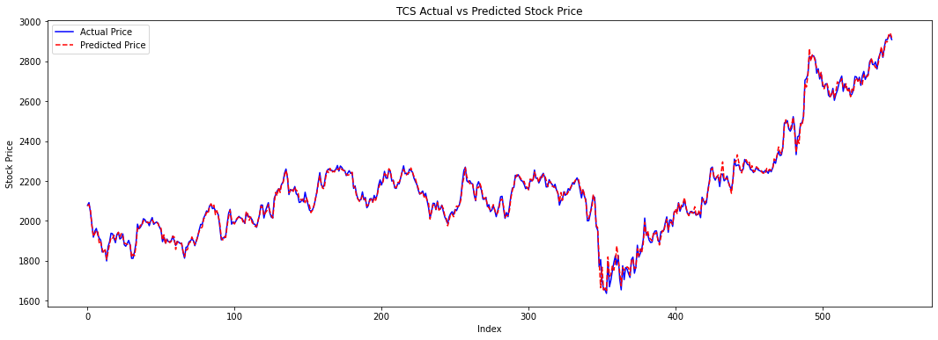
TCS ML Prediction

Slide 20
References
Research Papers:
Yadav, K., Yadav, M., & Saini, S. (2021). Stock values predictions using deep learning based hybrid models. CAAI Transactions on Intelligence Technology, 6(3), 266-277. https://doi.org/10.1049/cit2.12052
Long, W., Gao, J., Bai, K., & others. (2024). A hybrid model for stock price prediction based on multi-view heterogeneous data. Financial Innovation, 10, 48. https://doi.org/10.1186/s40854-023-00519-w
Srivinay, Manujakshi, B. C., Kabadi, M. G., & Naik, N. (2022). A hybrid stock price prediction model based on PRE and deep neural network. Data, 7(5), 51. https://doi.org/10.3390/data7050051

Slide 21
Thank you

